Slide 1













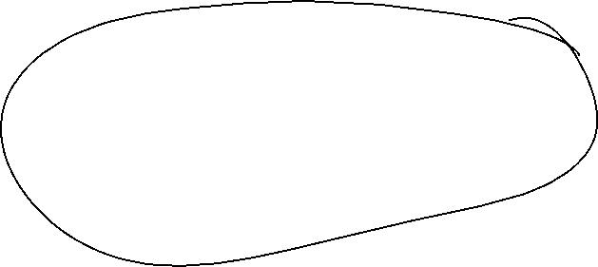















Slide 2












Slide 3









Slide 4














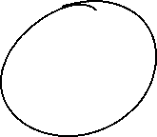












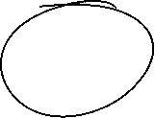














Slide 5








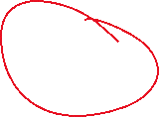





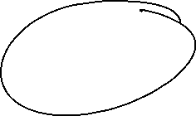

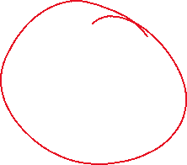
















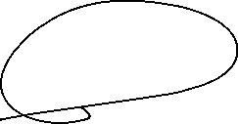













Slide 6



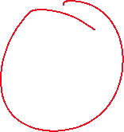



























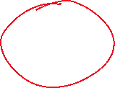
































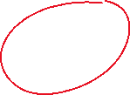


Slide 7






































Slide 8

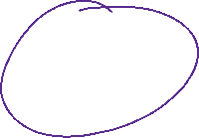


























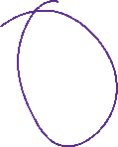






















Slide 9

























Slide 10

































Slide 11


























Slide 12






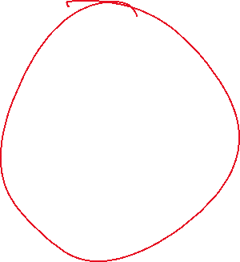
















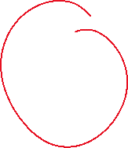











Slide 13












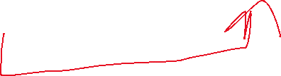








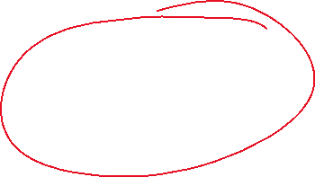
























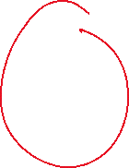


















Slide 14



















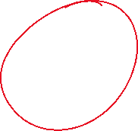














Slide 15

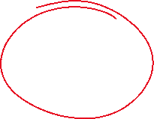













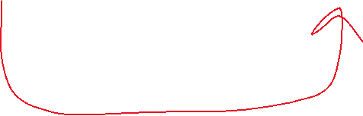















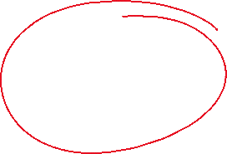












Slide 16









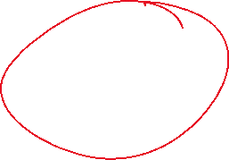
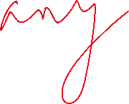












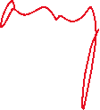


Slide 17







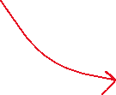
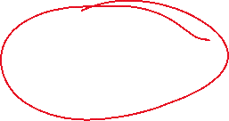

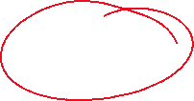







Slide 18



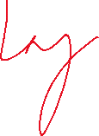

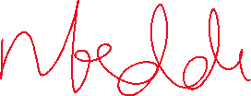




















Slide 19
Parameters count in RNN/Activation/Type of RNN/Variants
https://stanford.edu/~shervine/teaching/cs-230/cheatsheet-recurrent-neural-networks/
https://community.deeplearning.ai/t/how-to-compute-rnn-parameters/259287/4
https://www.geeksforgeeks.org/deep-learning/how-to-calculate-the-number-of-parameters-in-cnn/
https://www.geeksforgeeks.org/deep-learning/how-to-calculate-the-number-of-parameters-in-cnn/
Coding →
Numpy (Learning),
Keras https://d2l.ai/chapter_recurrent-neural-networks/rnn.html
Pytorch
…

Slide 20











































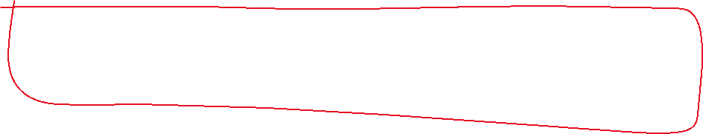




Slide 21




https://colab.research.google.com/github/tensorflow/docs/blob/master/site/en/tutorials/structured_data/time_series.ipynb
https://colab.research.google.com/github/DJCordhose/ml-workshop/blob/master/notebooks/tf2/time-series-rnn-full-predict.ipynb

